Slide 2

Mentoring Hub Subsystem Output
Tai Dang | 24.06.2024

Slide 3

Agenda
Mindmap
Usecase diagram
UI&UX design/Database Design
Q&A

Slide 4
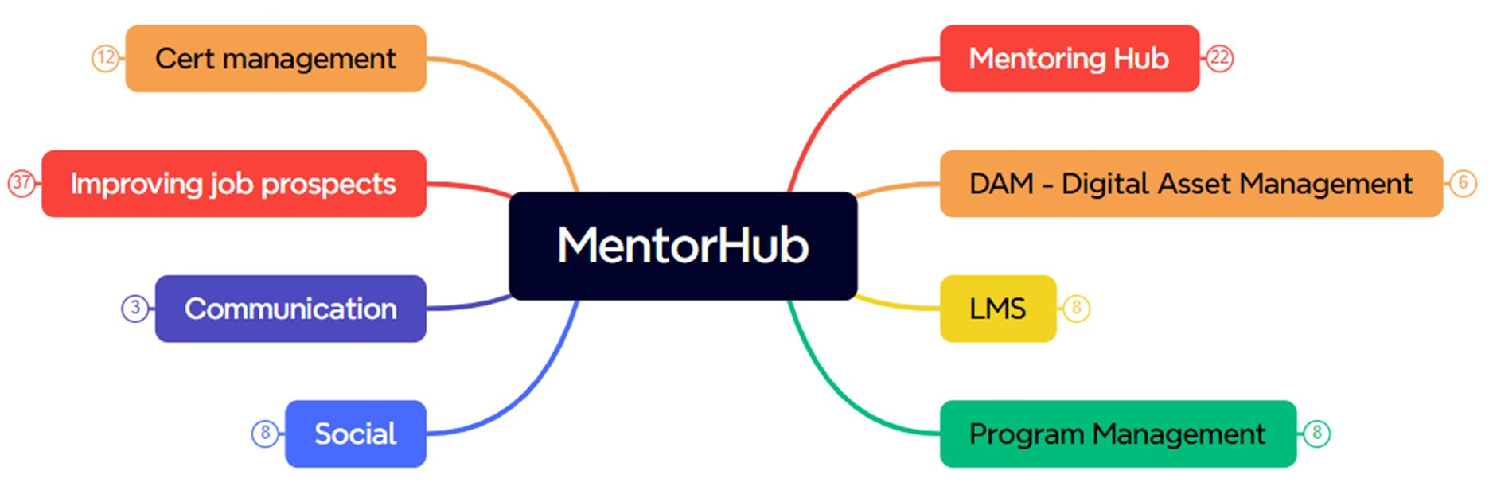

Slide 5
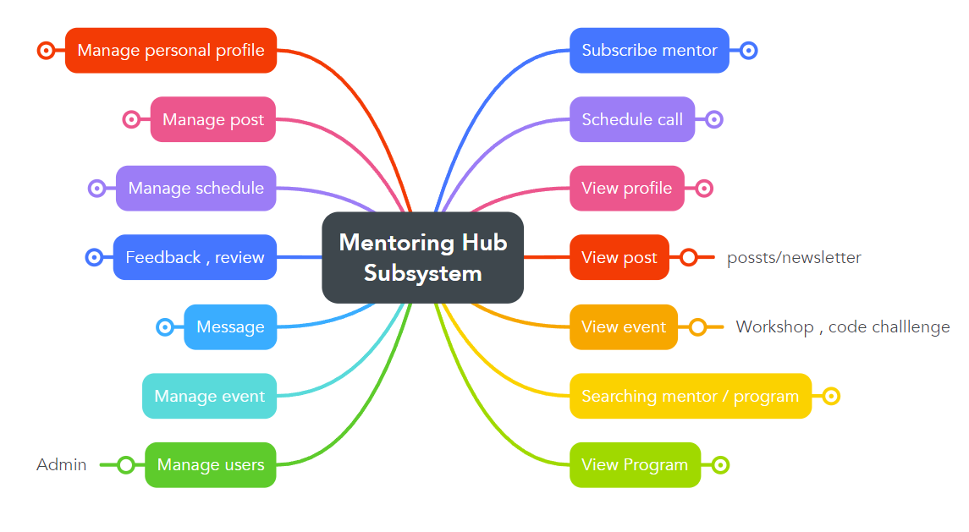

Slide 6
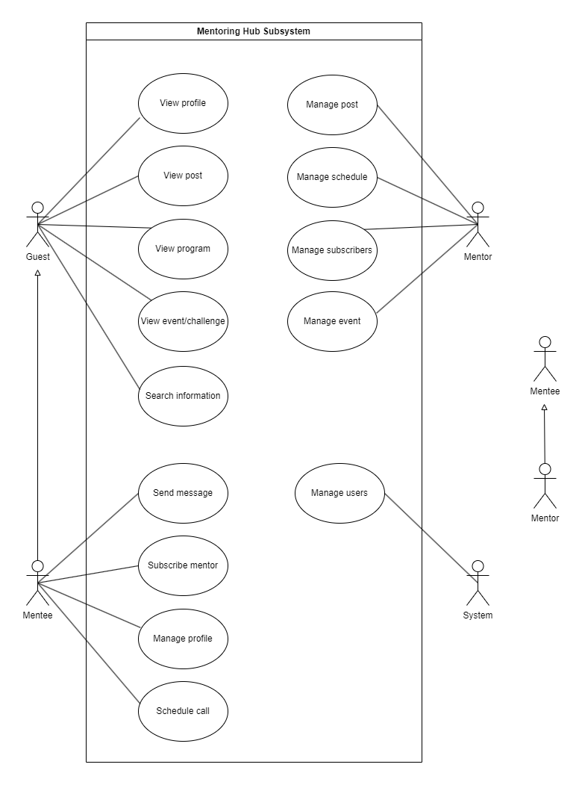
Use case diagram

Slide 7
Mentor List
Mentor Profile
Mentor manage followers
Mentor manage Post/Event
Mentee Profile
Admin Dashboard

Slide 8
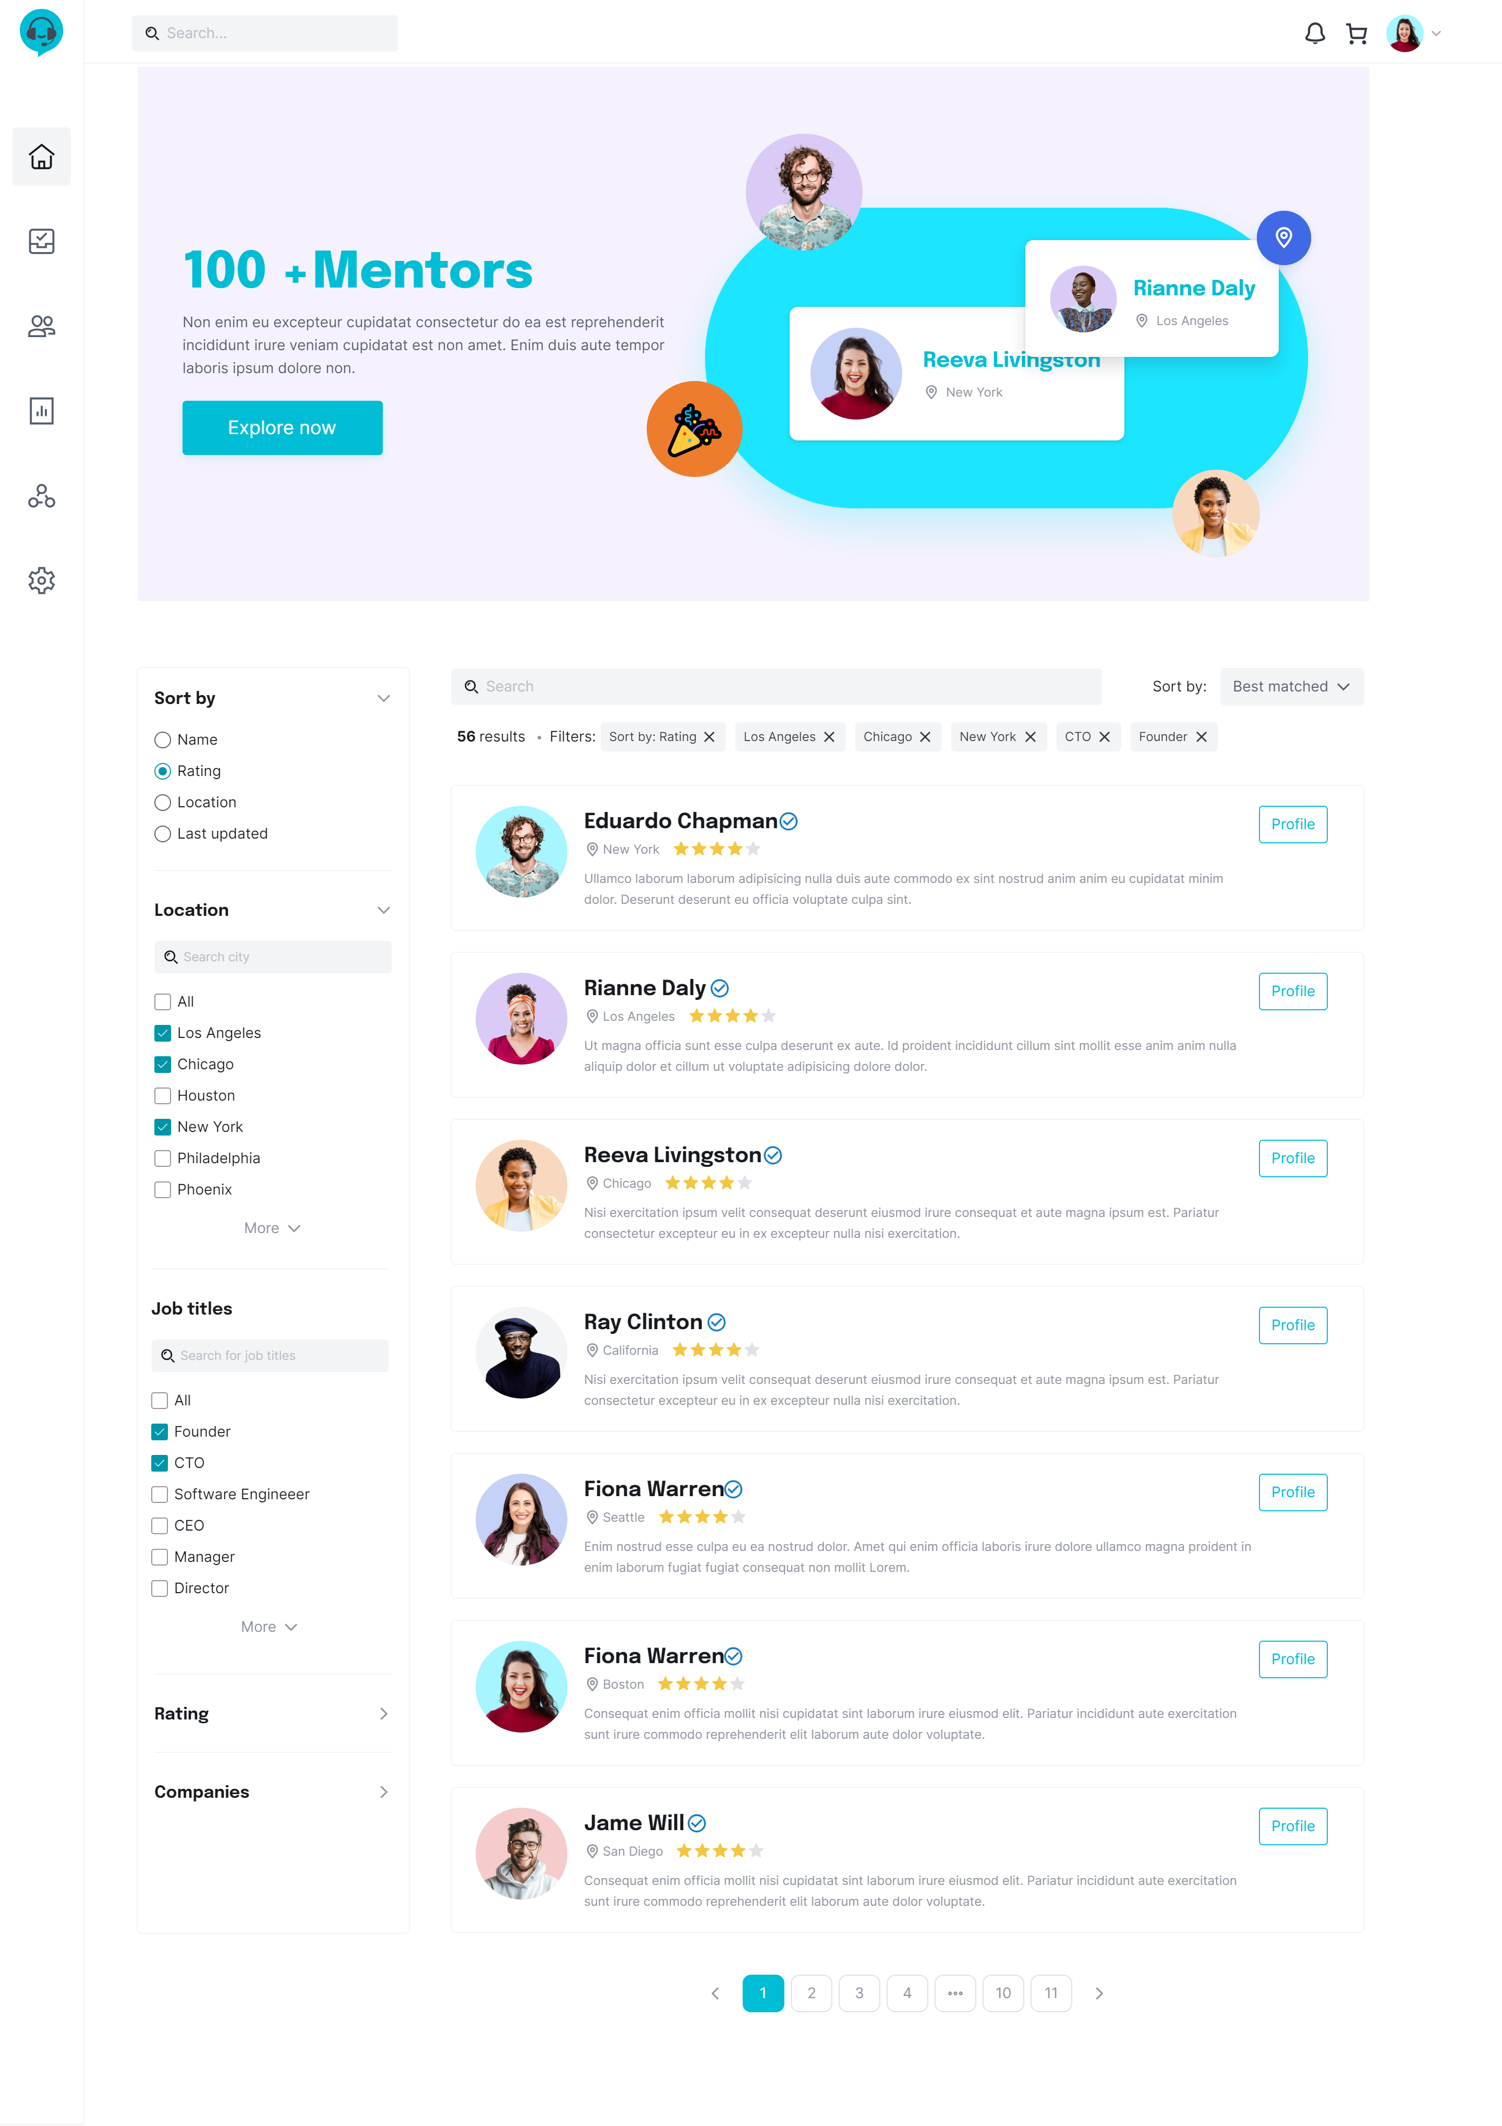
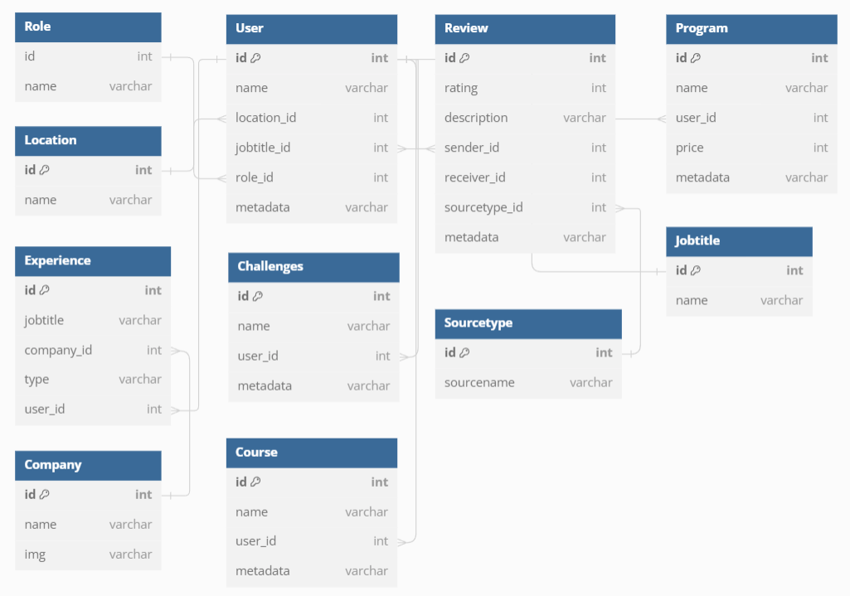
Mentor List

Slide 9
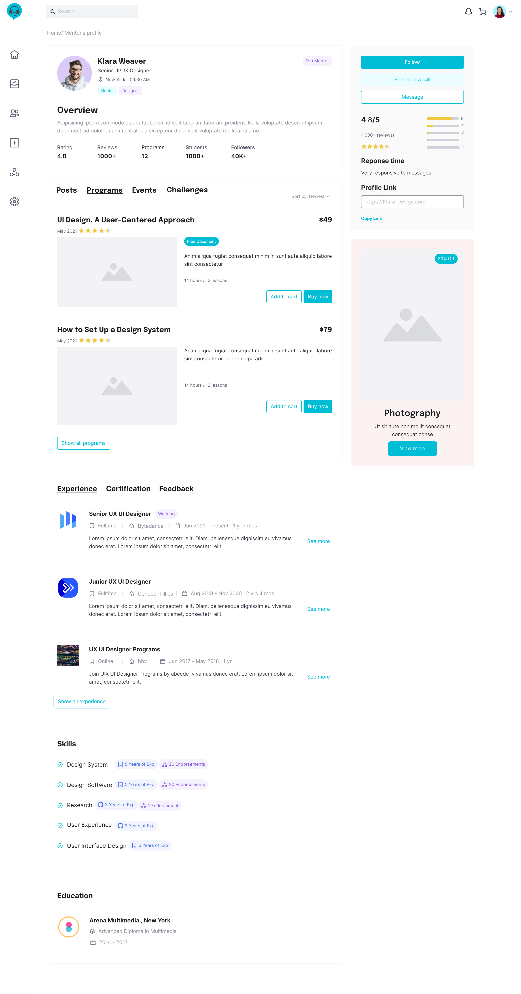
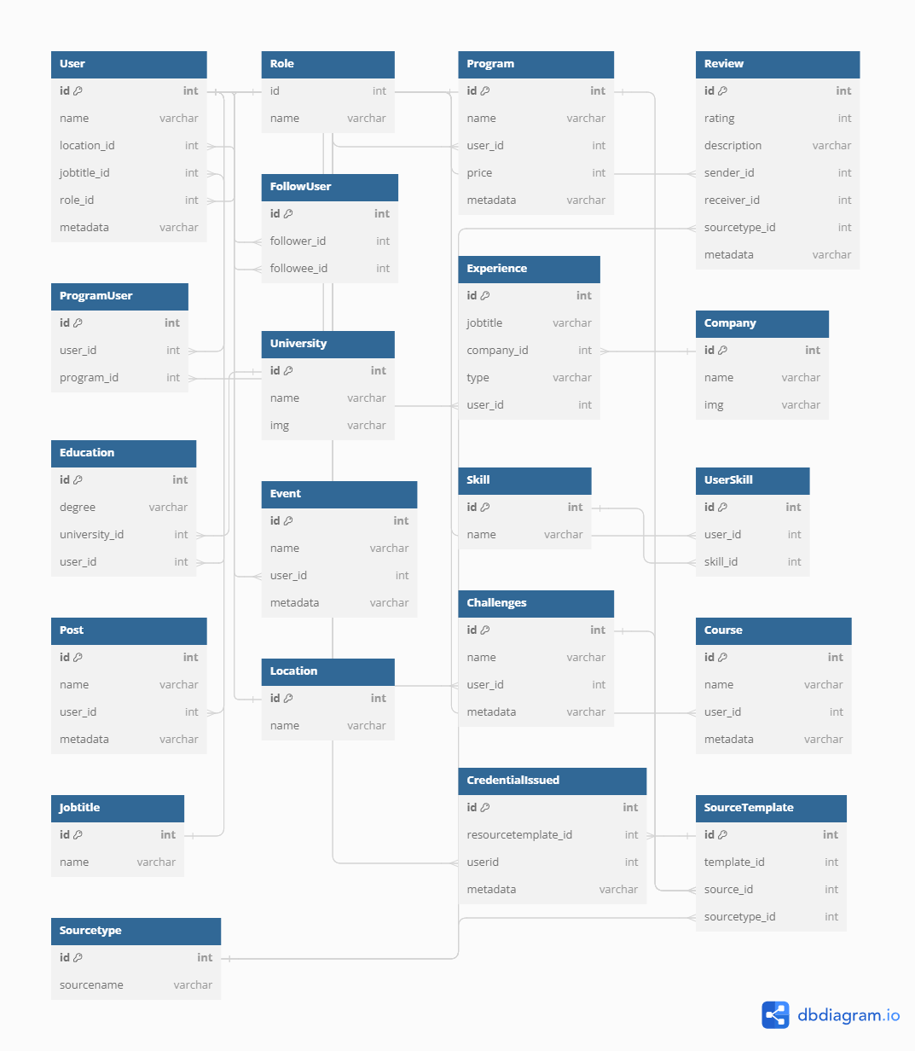
Mentor Profile

Slide 10
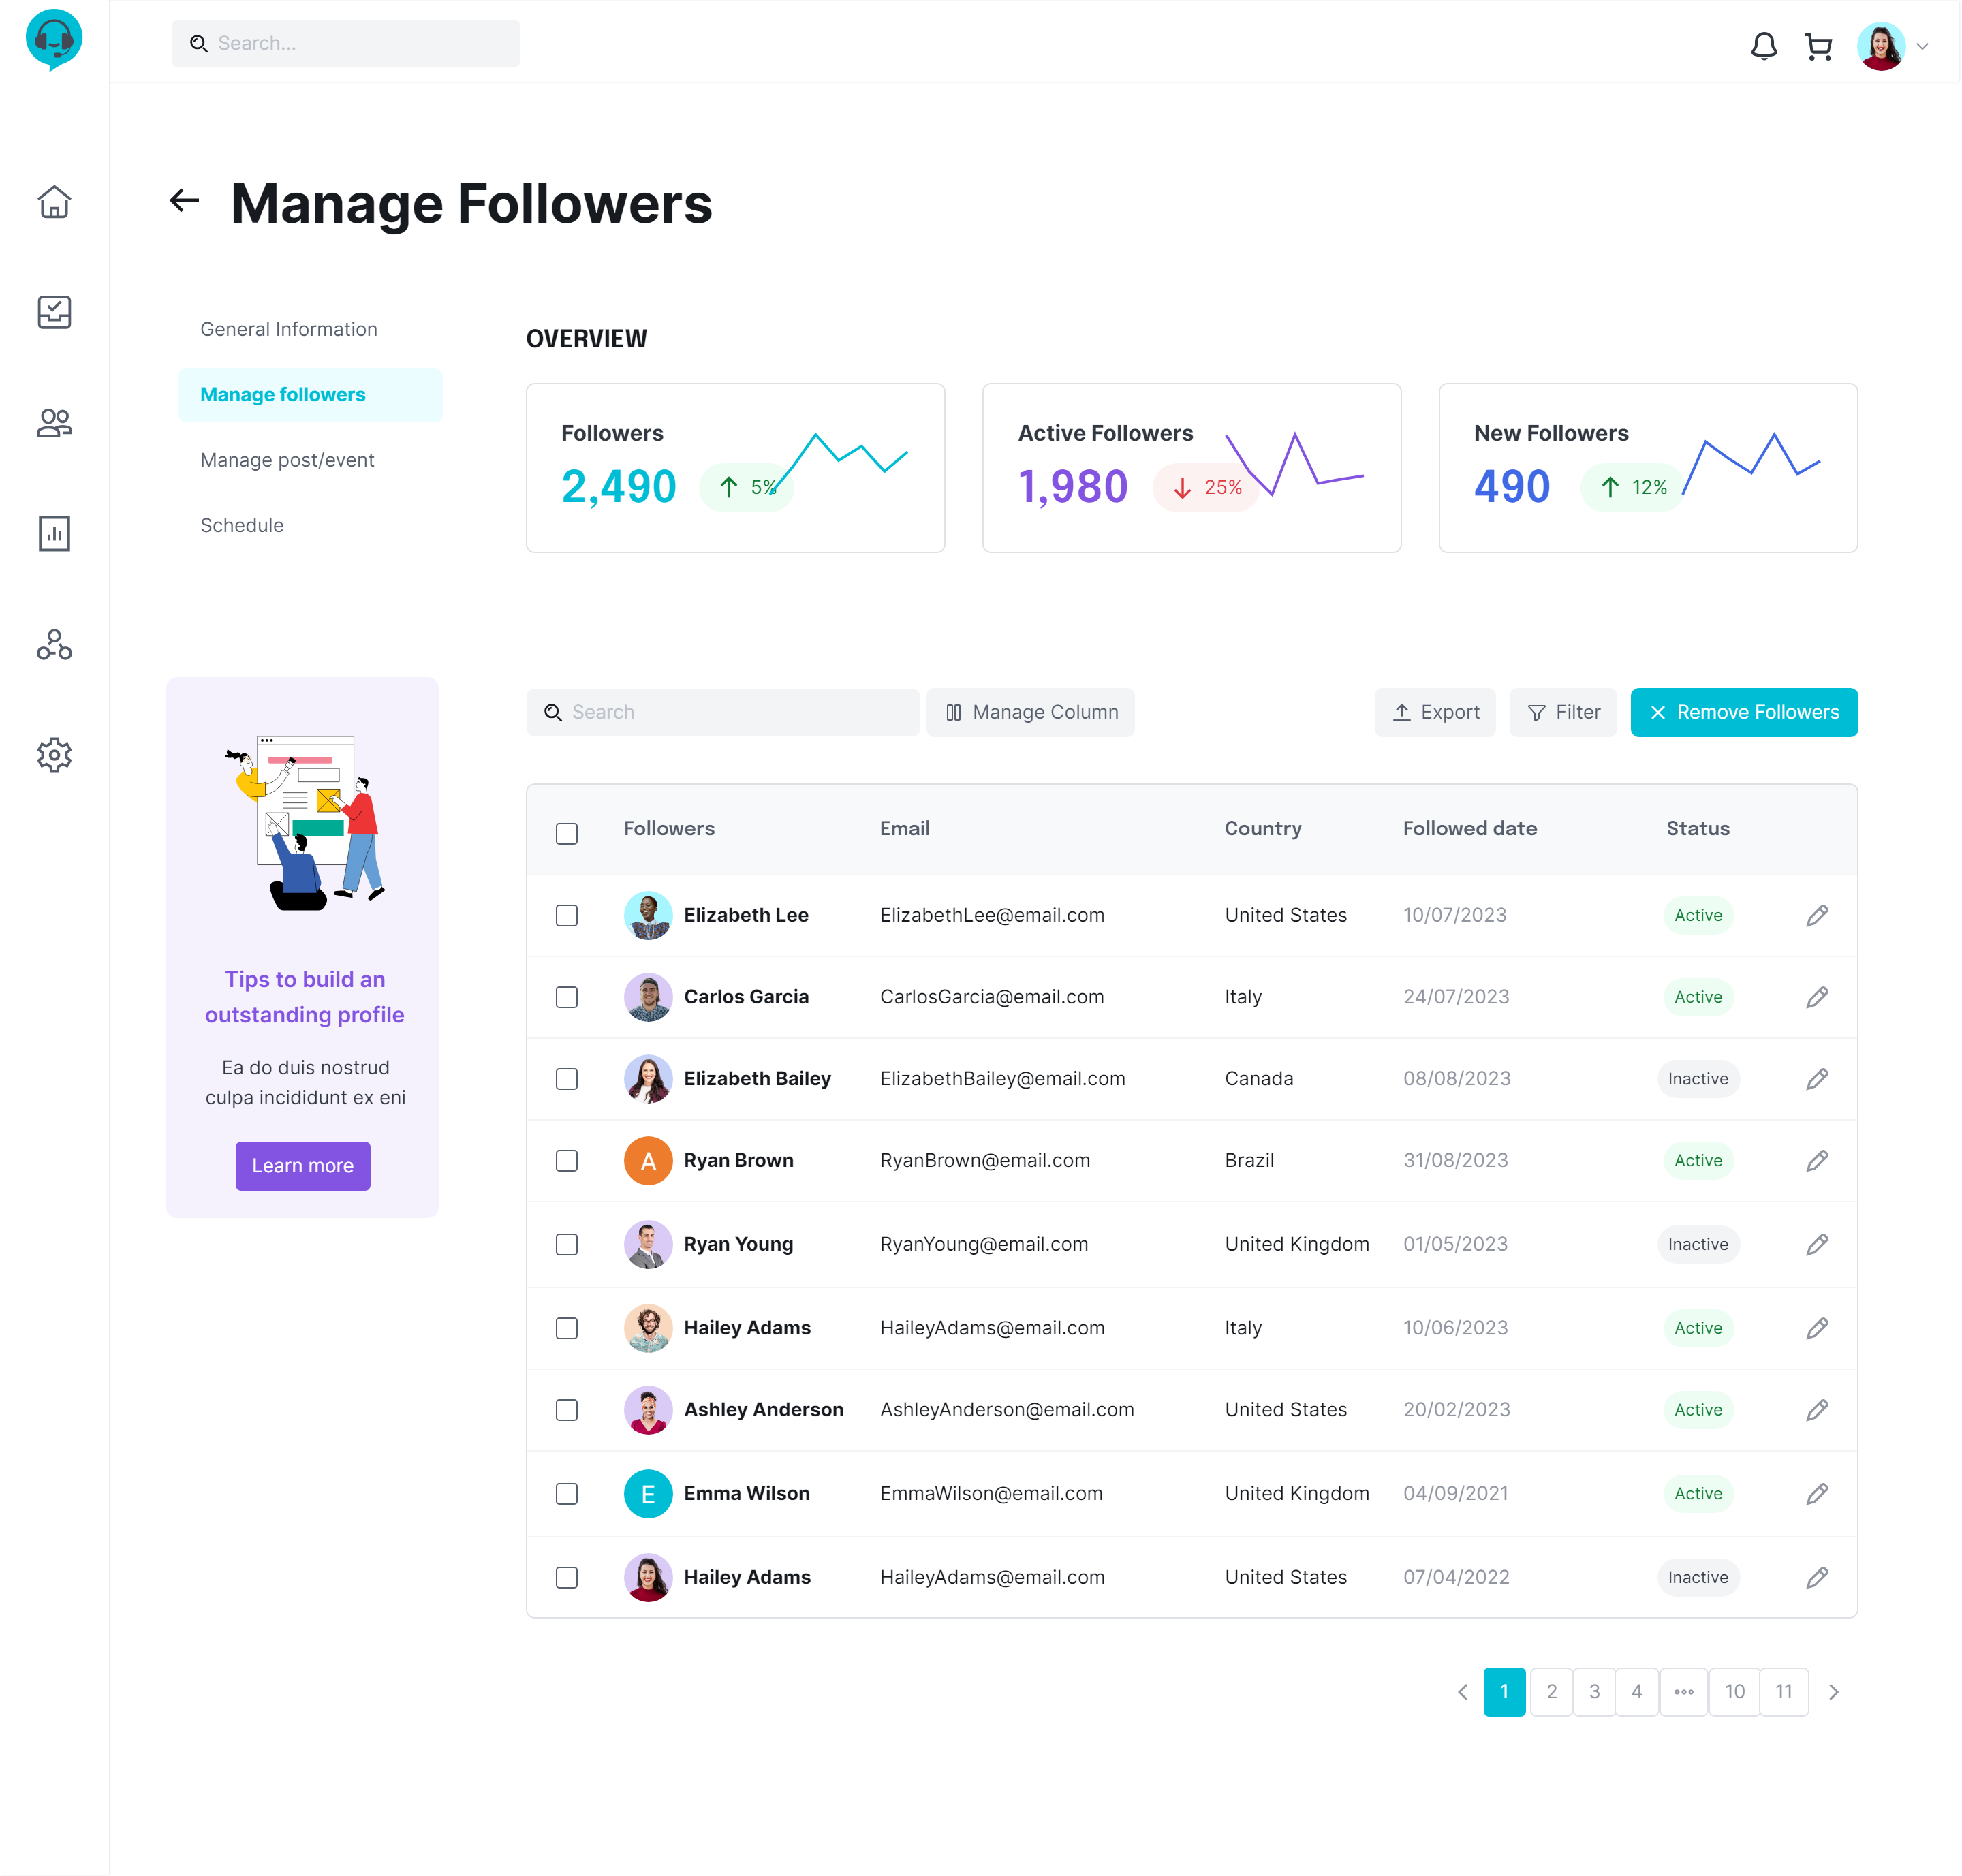
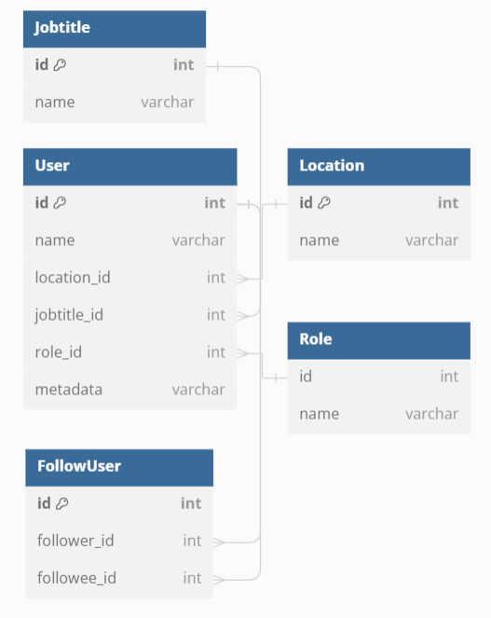
Mentor Manage Followers
Notes:
## SELECT ALL FOLLOWER
```sql
SELECT *
FROM Follow f
JOIN Userr u on f.follower_id = u.id
WHERE followee_id = 'U1'
```
## Dem so luong tat ca follower
```sql
SELECT count(*)
FROM Follow f
WHERE followee_id = 'U1'
```

Slide 11
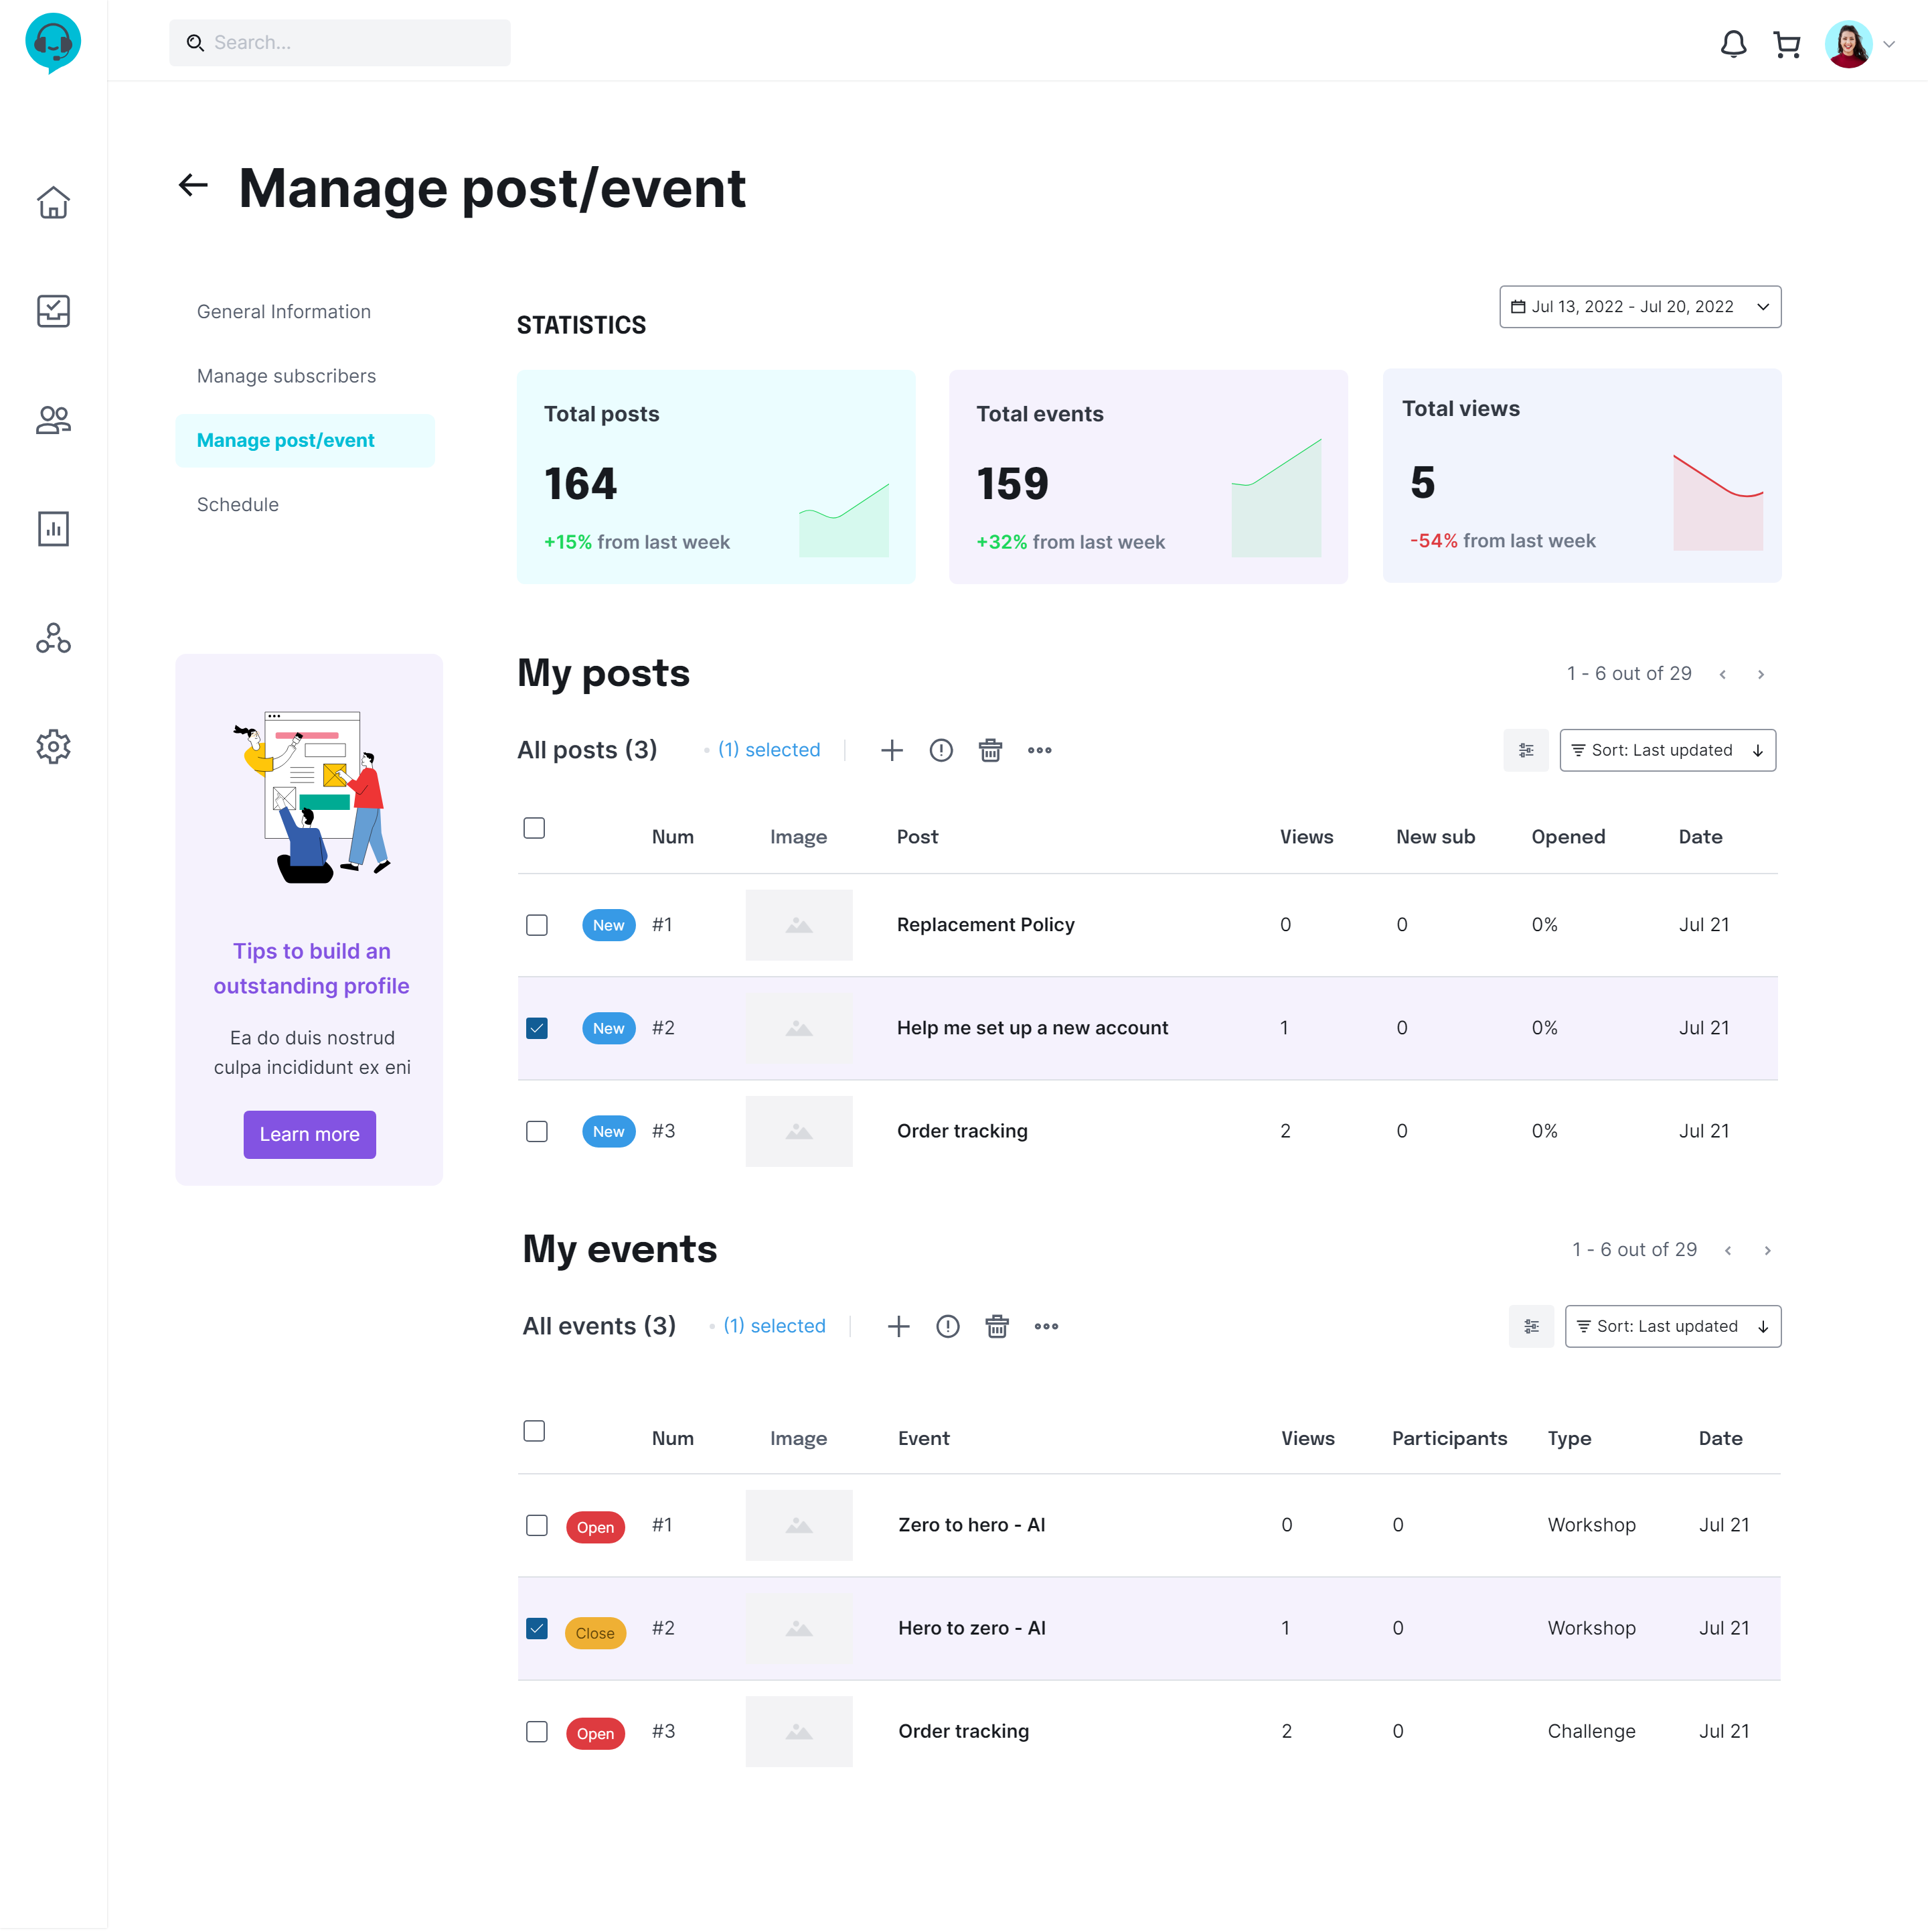
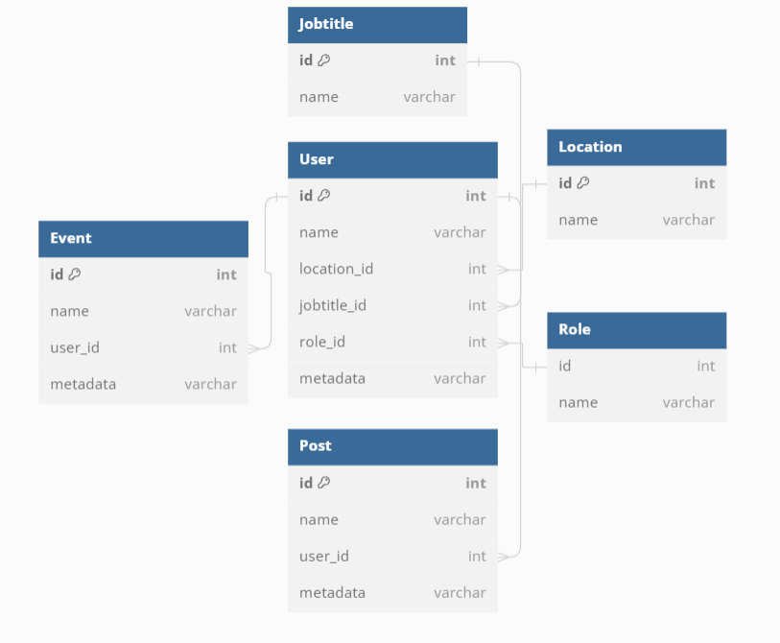
Mentor Manage Post/Event

Slide 12
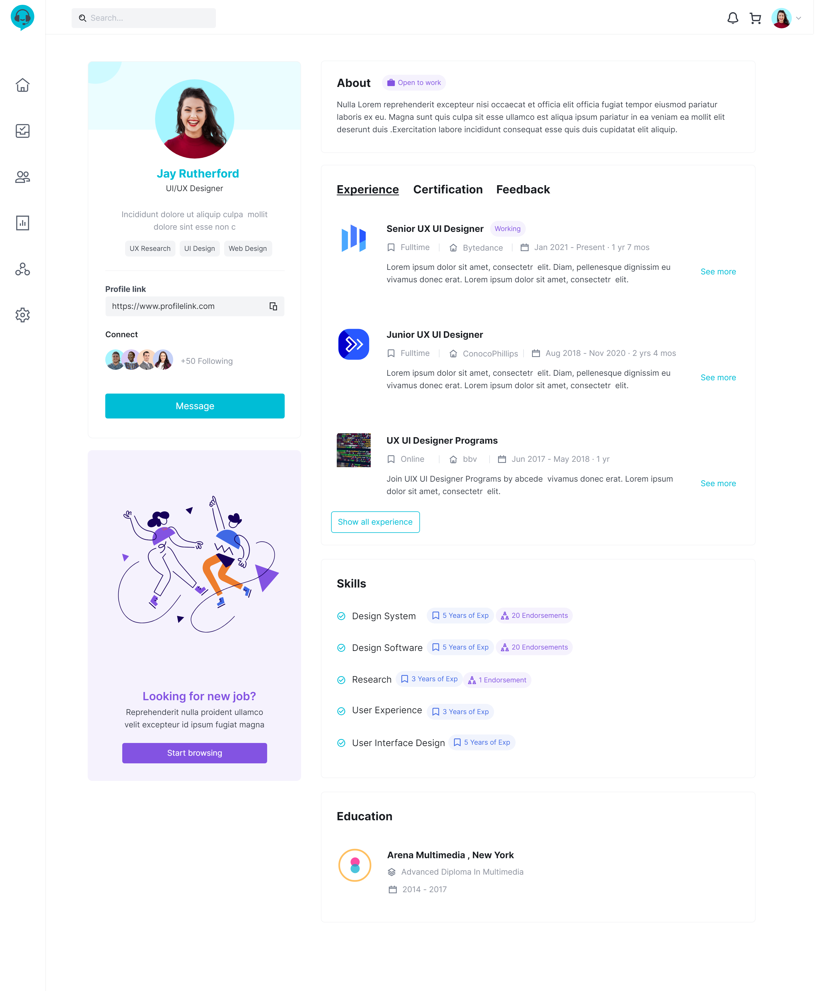
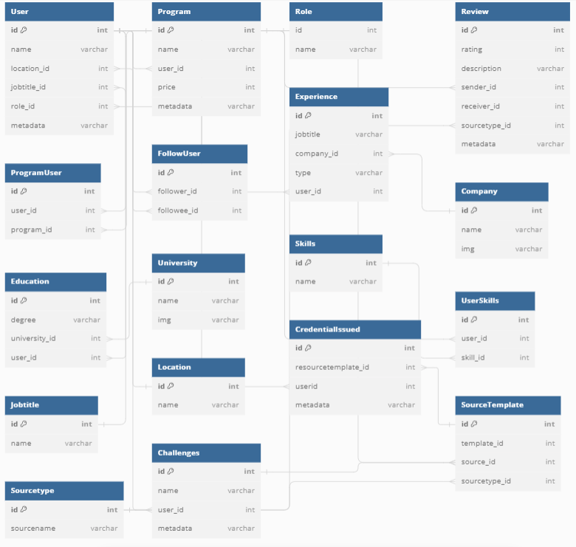
Mentee Profile
Notes:
## select thong tin co ban cua mentee và số lượng người mentee đang theo dõi
```sql
SELECT
u.id,
u.name,
j.name as jobtitle,
l.name as location,
r.name as role,
(SELECT COUNT(*)
FROM Follow
WHERE follower_id = 'U3') as total_followers
FROM Userr u
JOIN Jobtitle j on u.jobtitle_id = j.id
JOIN Location l on u.location_id = l.id
JOIN Role r on u.role_id = r.id
WHERE u.id = 'U3’;
## lay cert cua 1 user
```sql
SELECT ci.id AS CertID,
ci.credentialcode,
ci.certified_at,
COALESCE(p.name, c.name, ch.name) AS CertName
FROM CredentialIssued ci
JOIN SourceTemplate st ON ci.sourcetemplate_id = st.id
LEFT JOIN Program p ON st.source_id = p.id AND st.sourcetype_id = 'S3'
LEFT JOIN Course c ON st.source_id = c.id AND st.sourcetype_id = 'S1'
LEFT JOIN Challenge ch ON st.source_id = ch.id AND st.sourcetype_id = 'S2'
WHERE ci.user_id = 'U3';
```
## lay experience cua 1 user
```sql
SELECT
j.name as jobtitle,
c.name AS company_name,
e.type
FROM
Experience e
JOIN
Company c ON e.company_id = c.id
JOIN
Jobtitle j on e.jobtitle_id = j.id
WHERE
e.user_id = 'U4'
UNION
SELECT
p.name AS jobtitle,
u.name AS company_name,
'Training' AS type
FROM
ProgramUser pu
JOIN
Program p ON pu.program_id = p.id
JOIN
Userr u ON p.mentor_id = u.id
WHERE
pu.user_id = 'U4' and pu.status ='Completed';
```

Slide 13
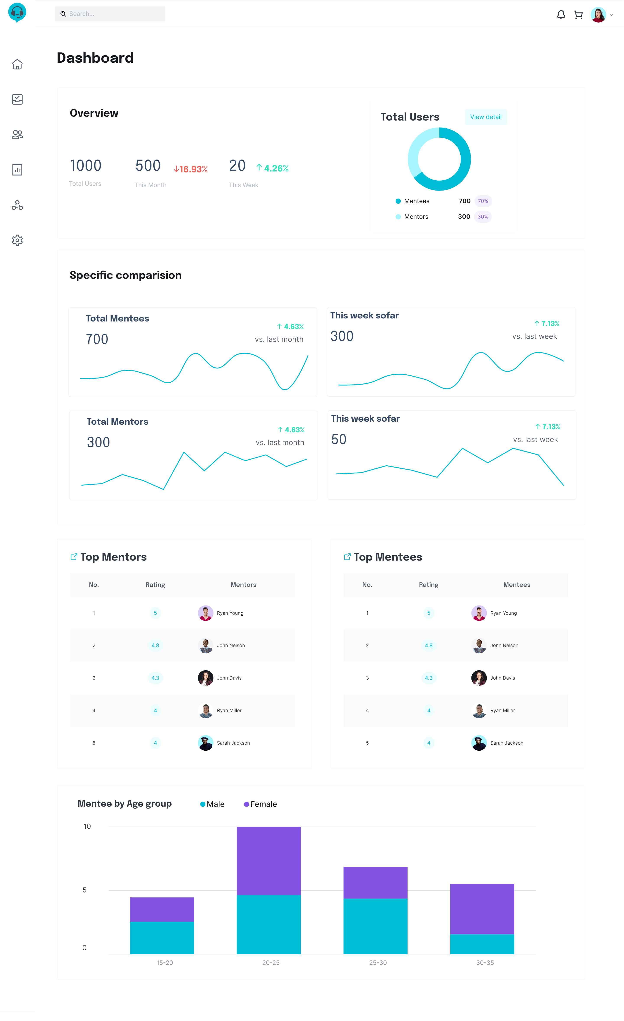
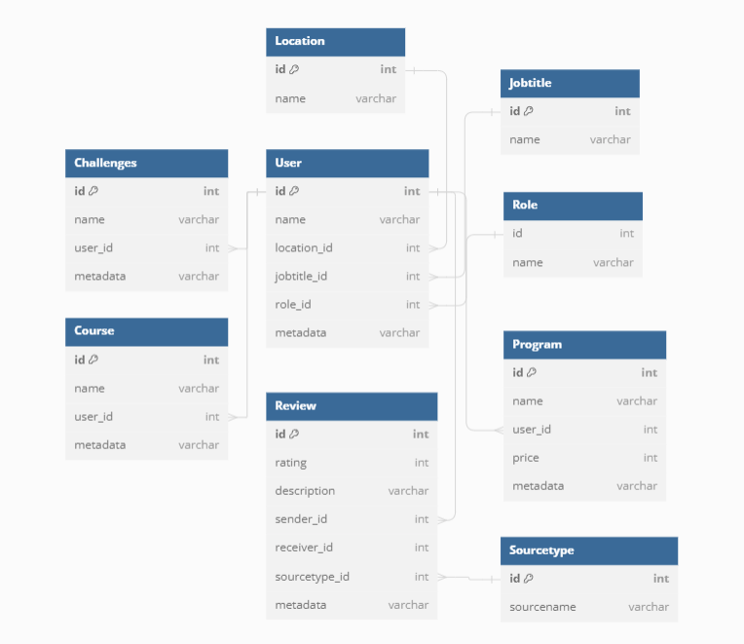
Admin/Dashboard

Slide 14

Questions & Answers

Slide 15


